Slide 1
Chapter 12: File System Implementation
File System Structure
File System Implementation
Directory Implementation
Allocation Methods
Free-Space Management
Efficiency and Performance
Recovery
Log-Structured File Systems
NFS

Slide 2
File-System Structure
File structure
  Logical storage unit
  Collection of related information
File system resides on secondary storage (disks).
File system organized into layers.
File control block – storage structure consisting of information about a file.

Slide 3
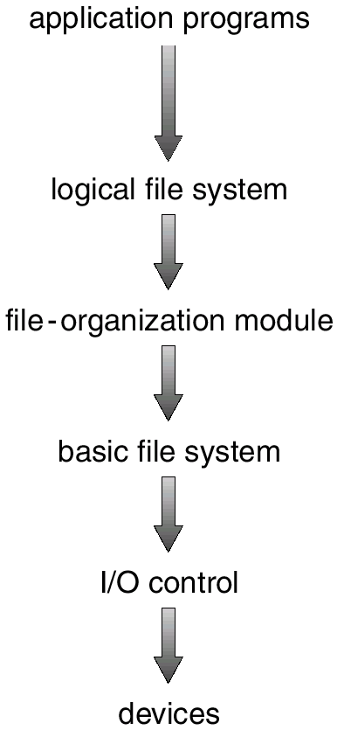
Layered File System

Slide 4
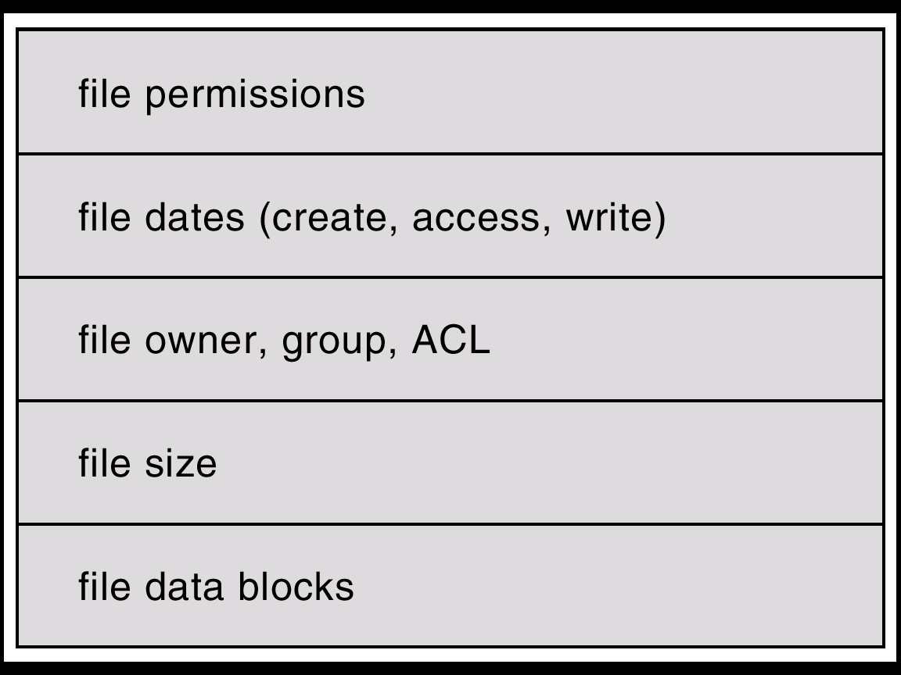
A Typical File Control Block

Slide 5
In-Memory File System Structures
The following figure illustrates the necessary file system structures provided by the operating systems.
Figure 12-3(a) refers to opening a file.
Figure 12-3(b) refers to reading a file.

Slide 6
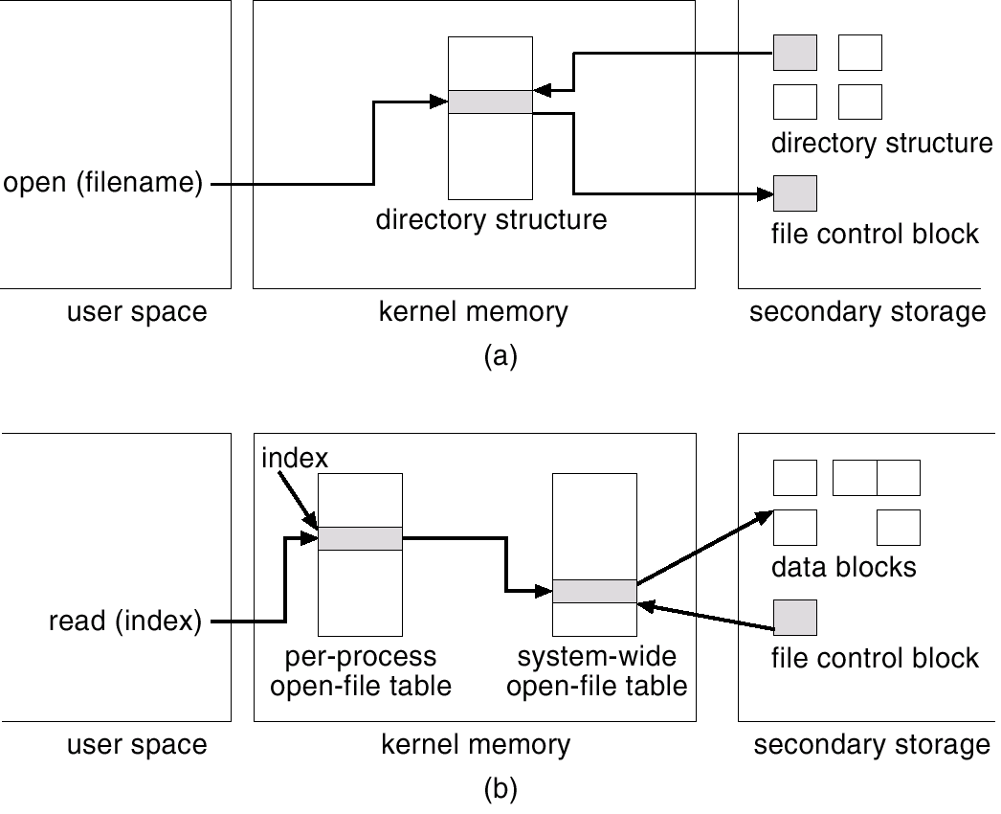
In-Memory File System Structures

Slide 7
Virtual File Systems
Virtual File Systems (VFS) provide an object-oriented way of implementing file systems.
VFS allows the same system call interface (the API) to be used for different types of file systems.
The API is to the VFS interface, rather than any specific type of file system.

Slide 8
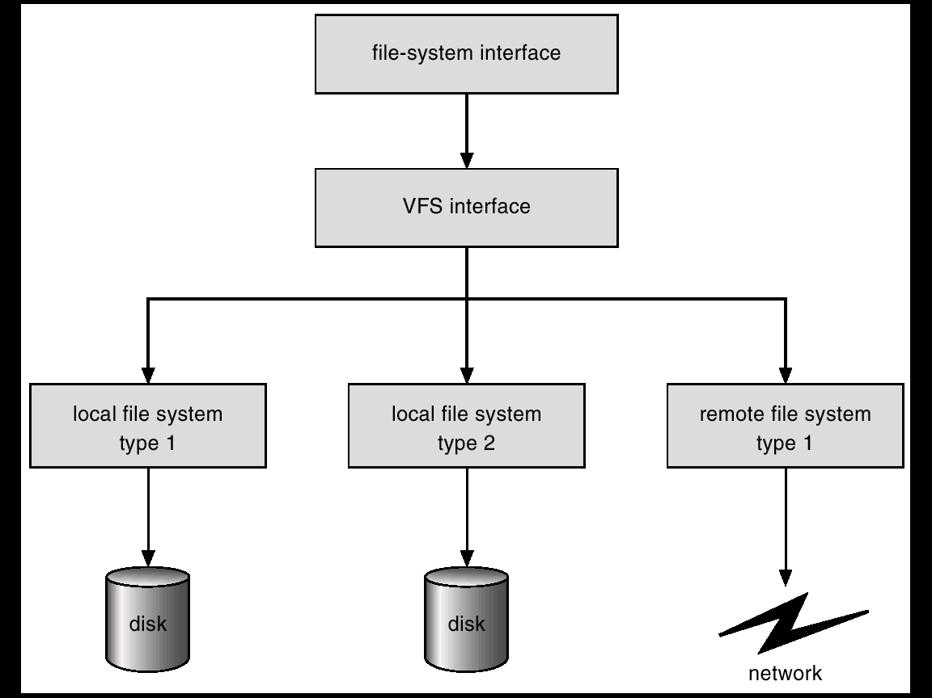
Schematic View of Virtual File System

Slide 9
Directory Implementation
Linear list of file names with pointer to the data blocks.
  simple to program
  time-consuming to execute
Hash Table – linear list with hash data structure.
  decreases directory search time
  collisions – situations where two file names hash to the same location
  fixed size

Slide 10
Allocation Methods
An allocation method refers to how disk blocks are allocated for files:
Contiguous allocation
Linked allocation
Indexed allocation

Slide 11
Contiguous Allocation
Each file occupies a set of contiguous blocks on the disk.
Simple – only starting location (block #) and length (number of blocks) are required.
Random access.
Wasteful of space (dynamic storage-allocation problem).
Files cannot grow.

Slide 12
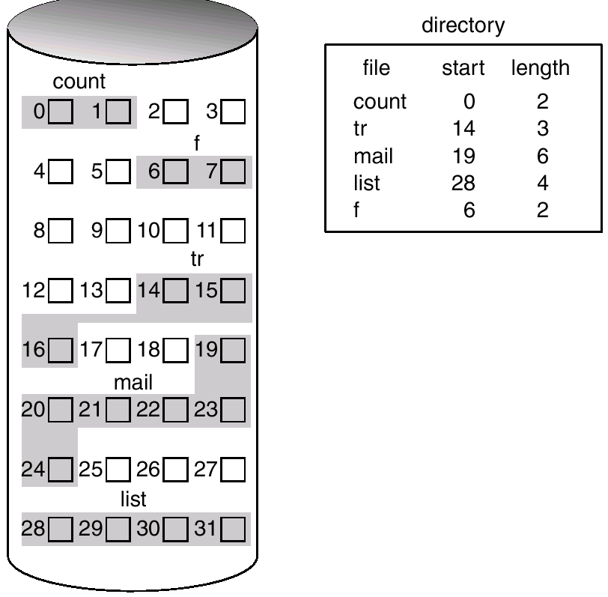
Contiguous Allocation of Disk Space

Slide 13
Extent-Based Systems
Many newer file systems (I.e. Veritas File System) use a modified contiguous allocation scheme.
Extent-based file systems allocate disk blocks in extents.
An extent is a contiguous block of disks. Extents are allocated for file allocation. A file consists of one or more extents.

Slide 14
Linked Allocation
Each file is a linked list of disk blocks: blocks may be scattered anywhere on the disk.
block =
pointer

Slide 15
Linked Allocation (Cont.)
Simple – need only starting address
Free-space management system – no waste of space
No random access
Mapping
Q
LA/511
R
  Block to be accessed is the Qth block in the linked chain of blocks representing the file.
  Displacement into block = R + 1
File-allocation table (FAT) – disk-space allocation used by MS-DOS and OS/2.

Slide 16
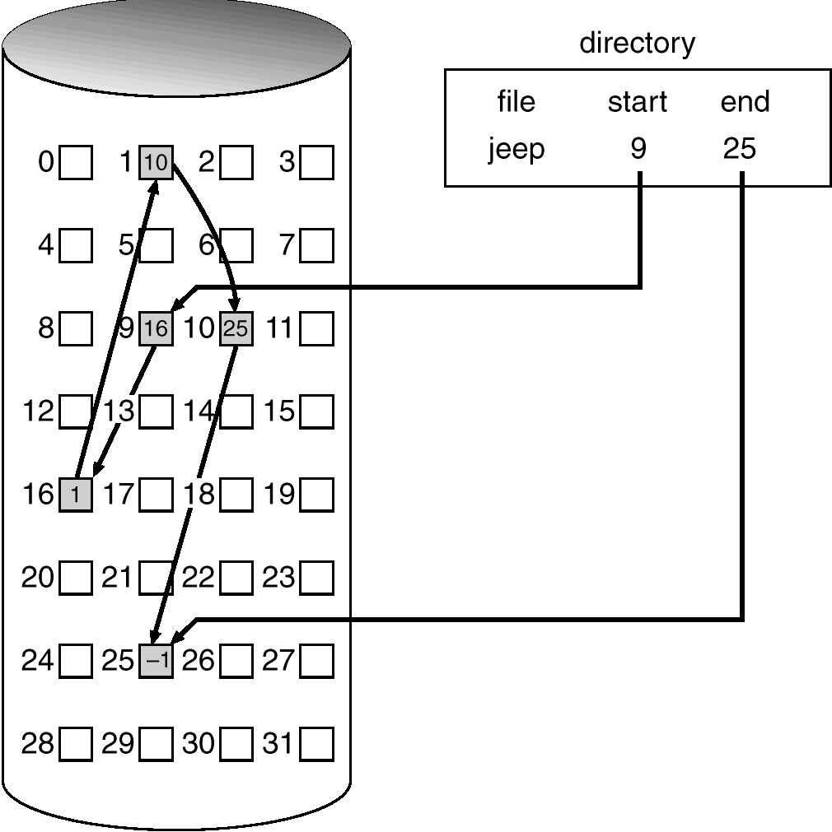
Linked Allocation

Slide 17
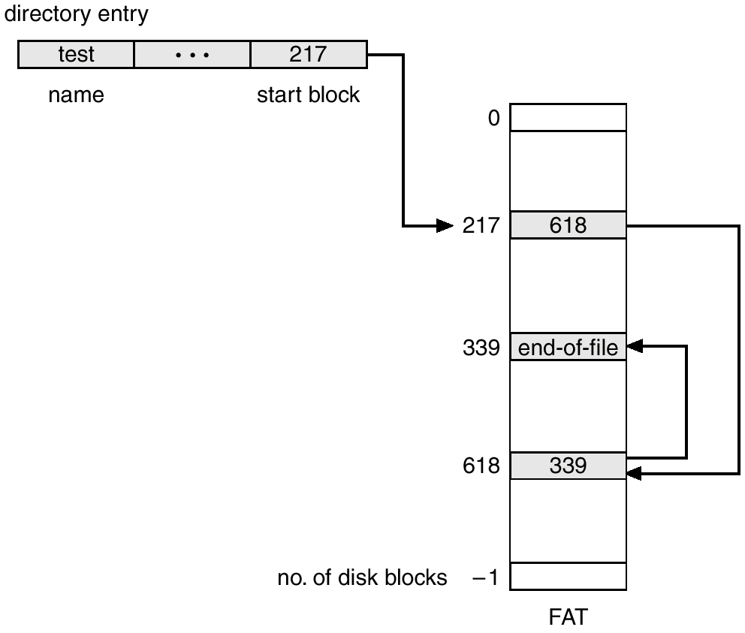
File-Allocation Table

Slide 18
Indexed Allocation
Brings all pointers together into the index block.
Logical view.
index table

Slide 19
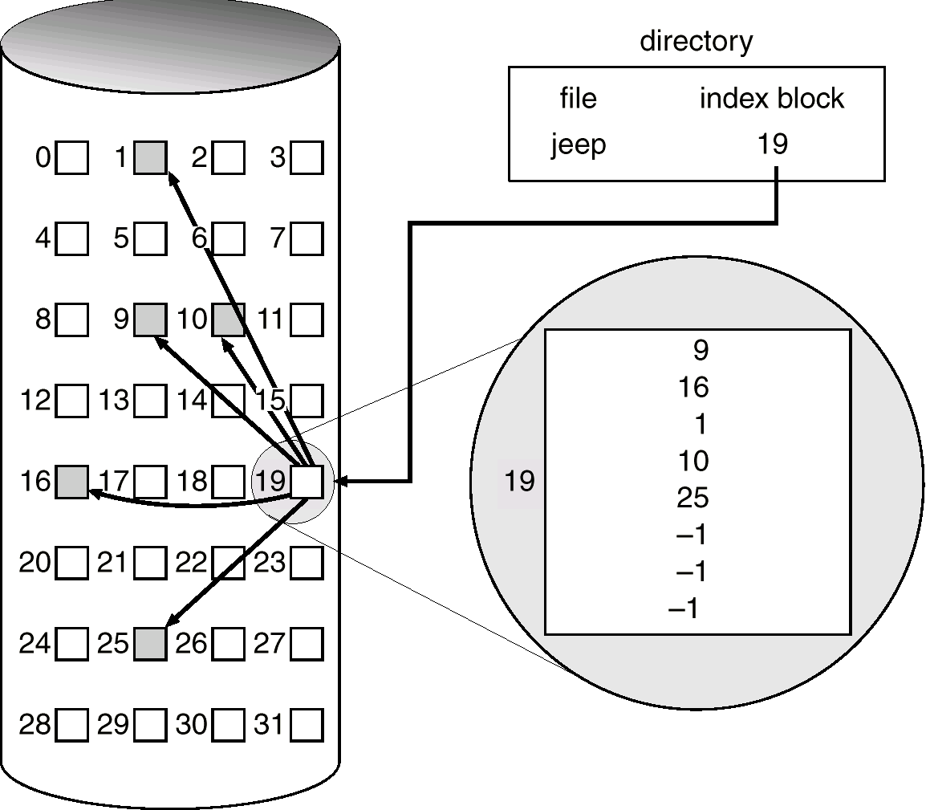
Example of Indexed Allocation

Slide 20
Indexed Allocation (Cont.)
Need index table
Random access
Dynamic access without external fragmentation, but have overhead of index block.
Mapping from logical to physical in a file of maximum size of 256K words and block size of 512 words. We need only 1 block for index table.
Q
LA/512
R
Q = displacement into index table
R = displacement into block

Slide 21
Indexed Allocation – Mapping (Cont.)
Mapping from logical to physical in a file of unbounded length (block size of 512 words).
Linked scheme – Link blocks of index table (no limit on size).
Q₁
LA / (512 x 511)
R₁
  Q₁ = block of index table
  R₁ is used as follows:
Q₂
R₁ / 512
R₂
  Q₂ = displacement into block of index table
  R₂ displacement into block of file:

Slide 22
Indexed Allocation – Mapping (Cont.)
Two-level index (maximum file size is 512³)
Q₁
LA / (512 x 512)
R₁
  Q₁ = displacement into outer-index
  R₁ is used as follows:
Q₂
R₁ / 512
R₂
  Q₂ = displacement into block of index table
  R₂ displacement into block of file:

Slide 23
Indexed Allocation – Mapping (Cont.)

outer-index
index table
file

Slide 24
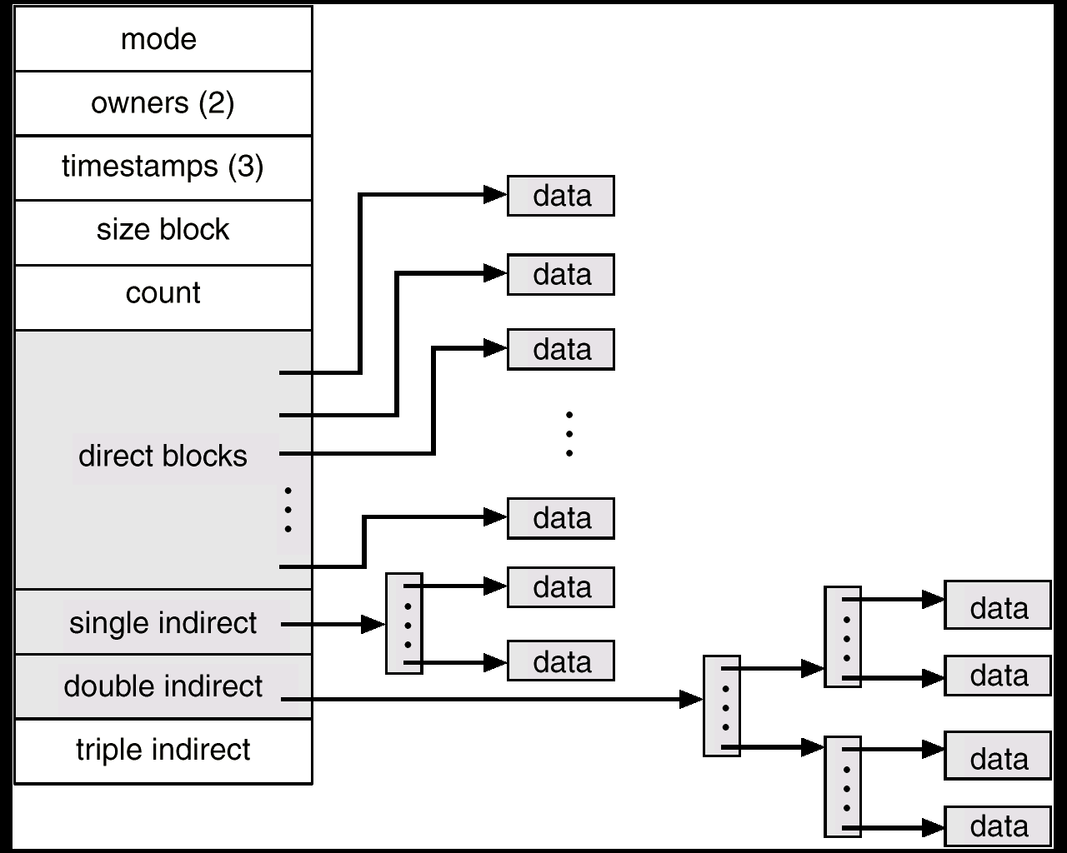
Combined Scheme: UNIX (4K bytes per block)

Slide 25
Free-Space Management
Bit vector (n blocks)
0
1
2
n-1
…
0 ⇒ block[i] free
1 ⇒ block[i] occupied
bit[i] =

Block number calculation
(number of bits per word) *
(number of 0-value words) +
offset of first 1 bit

Slide 26
Free-Space Management (Cont.)
Bit map requires extra space. Example:
block size = 2¹² bytes
disk size = 2³⁰ bytes (1 gigabyte)
n = 2³⁰/2¹² = 2¹⁸ bits (or 32K bytes)
Easy to get contiguous files
Linked list (free list)
  Cannot get contiguous space easily
  No waste of space
Grouping
Counting

Slide 27
Free-Space Management (Cont.)
Need to protect:
  Pointer to free list
  Bit map
    Must be kept on disk
    Copy in memory and disk may differ.
    Cannot allow for block[i] to have a situation where bit[i] = 1 in memory and bit[i] = 0 on disk.
  Solution:
    Set bit[i] = 1 in disk.
    Allocate block[i]
    Set bit[i] = 1 in memory

Slide 28
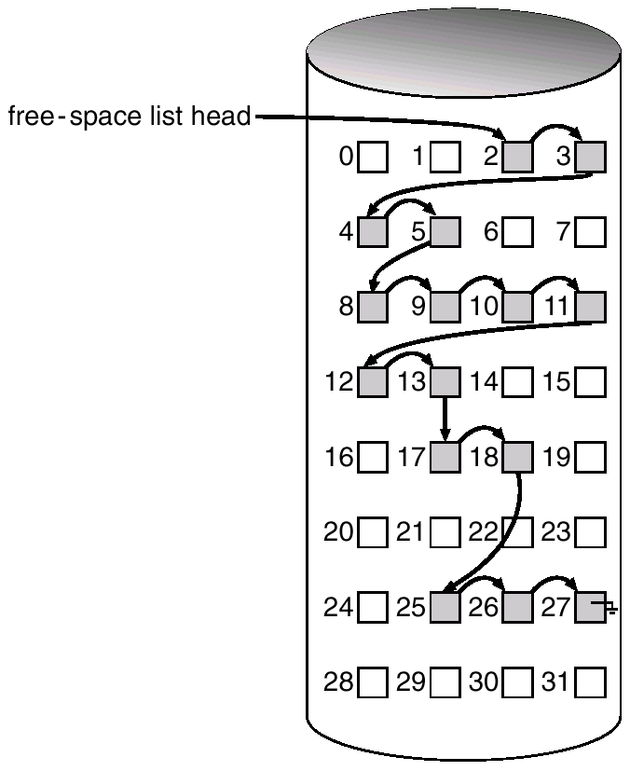
Linked Free Space List on Disk

Slide 29
Efficiency and Performance
Efficiency dependent on:
  disk allocation and directory algorithms
  types of data kept in file’s directory entry
Performance
  disk cache – separate section of main memory for frequently used blocks
  free-behind and read-ahead – techniques to optimize sequential access
  improve PC performance by dedicating section of memory as virtual disk, or RAM disk.

Slide 30
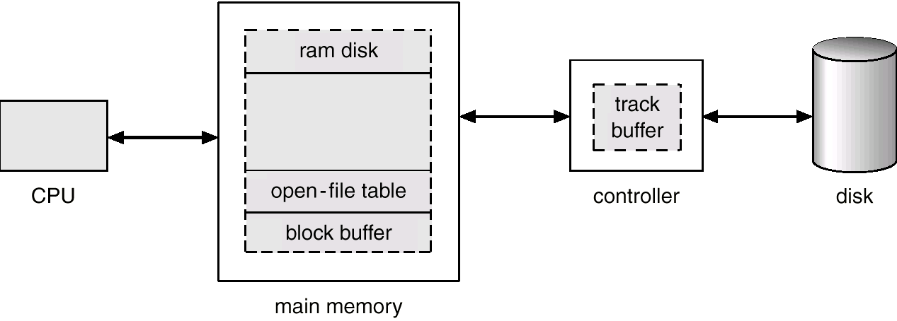
Various Disk-Caching Locations

Slide 31
Page Cache
A page cache caches pages rather than disk blocks using virtual memory techniques.
Memory-mapped I/O uses a page cache.
Routine I/O through the file system uses the buffer (disk) cache.
This leads to the following figure.

Slide 32
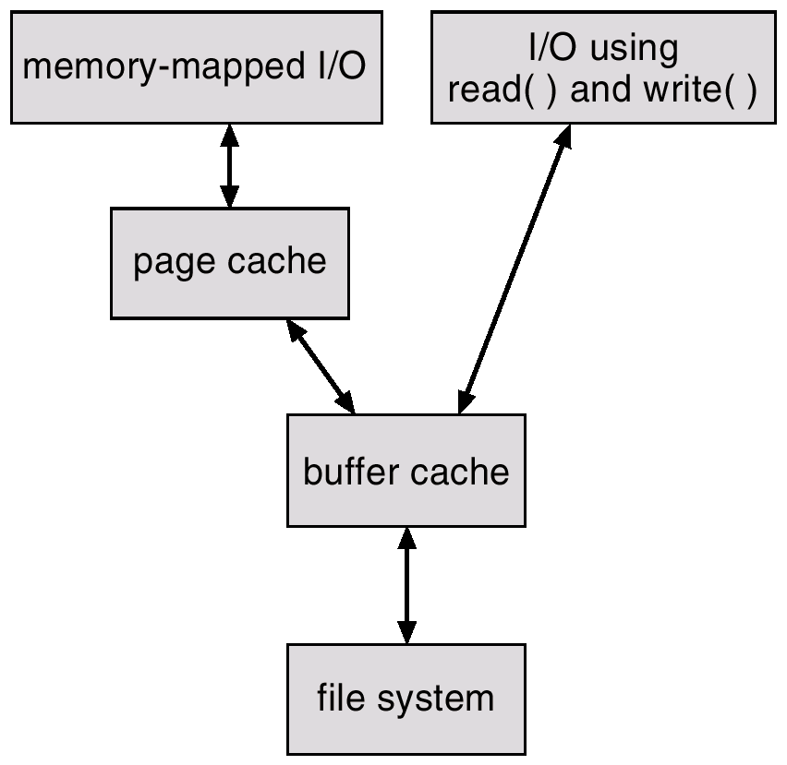
I/O Without a Unified Buffer Cache

Slide 33
Unified Buffer Cache
A unified buffer cache uses the same page cache to cache both memory-mapped pages and ordinary file system I/O.

Slide 34
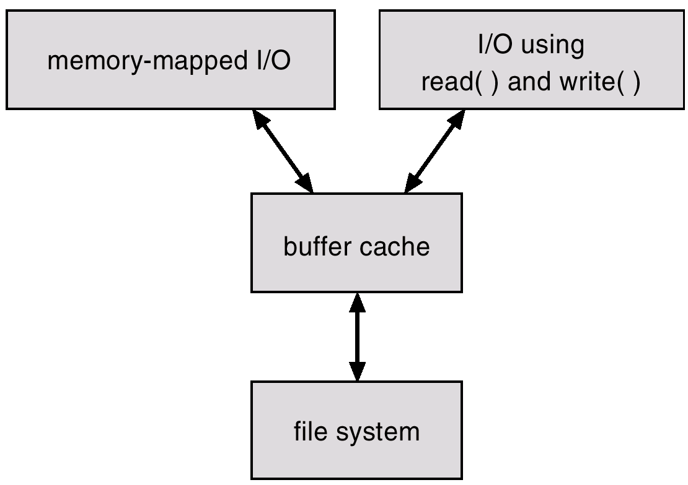
I/O Using a Unified Buffer Cache

Slide 35
Recovery
Consistency checking – compares data in directory structure with data blocks on disk, and tries to fix inconsistencies.
Use system programs to back up data from disk to another storage device (floppy disk, magnetic tape).
Recover lost file or disk by restoring data from backup.

Slide 36
Log Structured File Systems
Log structured (or journaling) file systems record each update to the file system as a transaction.
All transactions are written to a log. A transaction is considered committed once it is written to the log. However, the file system may not yet be updated.
The transactions in the log are asynchronously written to the file system. When the file system is modified, the transaction is removed from the log.
If the file system crashes, all remaining transactions in the log must still be performed.

Slide 37
The Sun Network File System (NFS)
An implementation and a specification of a software system for accessing remote files across LANs (or WANs).
The implementation is part of the Solaris and SunOS operating systems running on Sun workstations using an unreliable datagram protocol (UDP/IP protocol and Ethernet.

Slide 38
NFS (Cont.)
Interconnected workstations viewed as a set of independent machines with independent file systems, which allows sharing among these file systems in a transparent manner.
  A remote directory is mounted over a local file system directory. The mounted directory looks like an integral subtree of the local file system, replacing the subtree descending from the local directory.
  Specification of the remote directory for the mount operation is nontransparent; the host name of the remote directory has to be provided. Files in the remote directory can then be accessed in a transparent manner.
  Subject to access-rights accreditation, potentially any file system (or directory within a file system), can be mounted remotely on top of any local directory.

Slide 39
NFS (Cont.)
NFS is designed to operate in a heterogeneous environment of different machines, operating systems, and network architectures; the NFS specifications independent of these media.
This independence is achieved through the use of RPC primitives built on top of an External Data Representation (XDR) protocol used between two implementation-independent interfaces.
The NFS specification distinguishes between the services provided by a mount mechanism and the actual remote-file-access services.

Slide 40
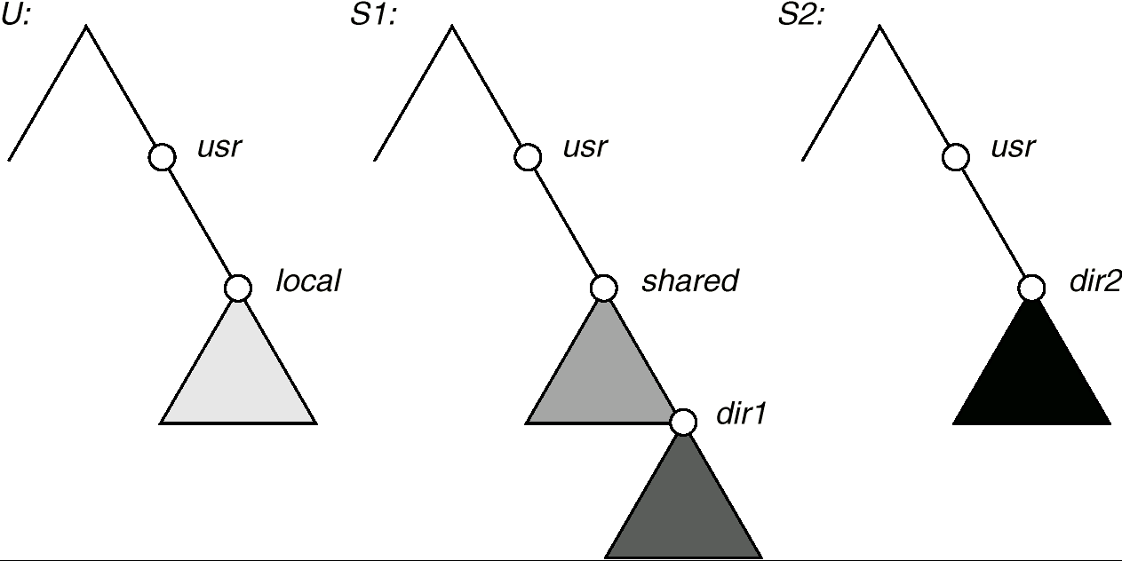
Three Independent File Systems

Slide 41
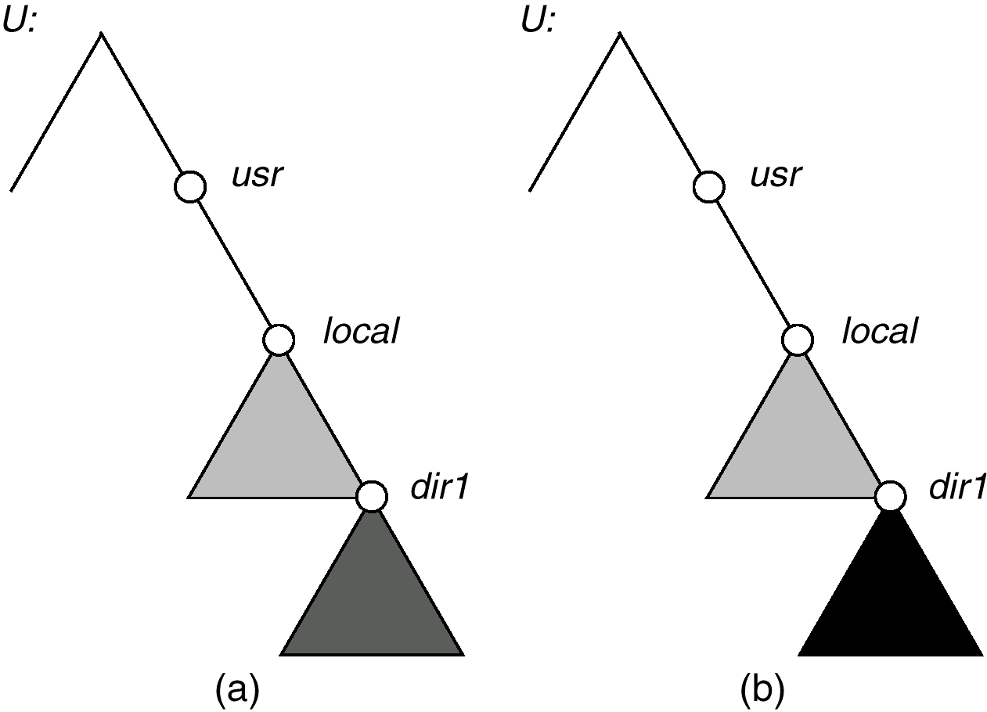
Mounting in NFS
Mounts
Cascading mounts

Slide 42
NFS Mount Protocol
Establishes initial logical connection between server and client.
Mount operation includes name of remote directory to be mounted and name of server machine storing it.
  Mount request is mapped to corresponding RPC and forwarded to mount server running on server machine.
  Export list – specifies local file systems that server exports for mounting, along with names of machines that are permitted to mount them.
Following a mount request that conforms to its export list, the server returns a file handle—a key for further accesses.
File handle – a file-system identifier, and an inode number to identify the mounted directory within the exported file system.
The mount operation changes only the user’s view and does not affect the server side.

Slide 43
NFS Protocol
Provides a set of remote procedure calls for remote file operations. The procedures support the following operations:
  searching for a file within a directory
  reading a set of directory entries
  manipulating links and directories
  accessing file attributes
  reading and writing files
NFS servers are stateless; each request has to provide a full set of arguments.
Modified data must be committed to the server’s disk before results are returned to the client (lose advantages of caching).
The NFS protocol does not provide concurrency-control mechanisms.

Slide 44
Three Major Layers of NFS Architecture
UNIX file-system interface (based on the open, read, write, and close calls, and file descriptors).
Virtual File System (VFS) layer – distinguishes local files from remote ones, and local files are further distinguished according to their file-system types.
  The VFS activates file-system-specific operations to handle local requests according to their file-system types.
  Calls the NFS protocol procedures for remote requests.
NFS service layer – bottom layer of the architecture; implements the NFS protocol.

Slide 45
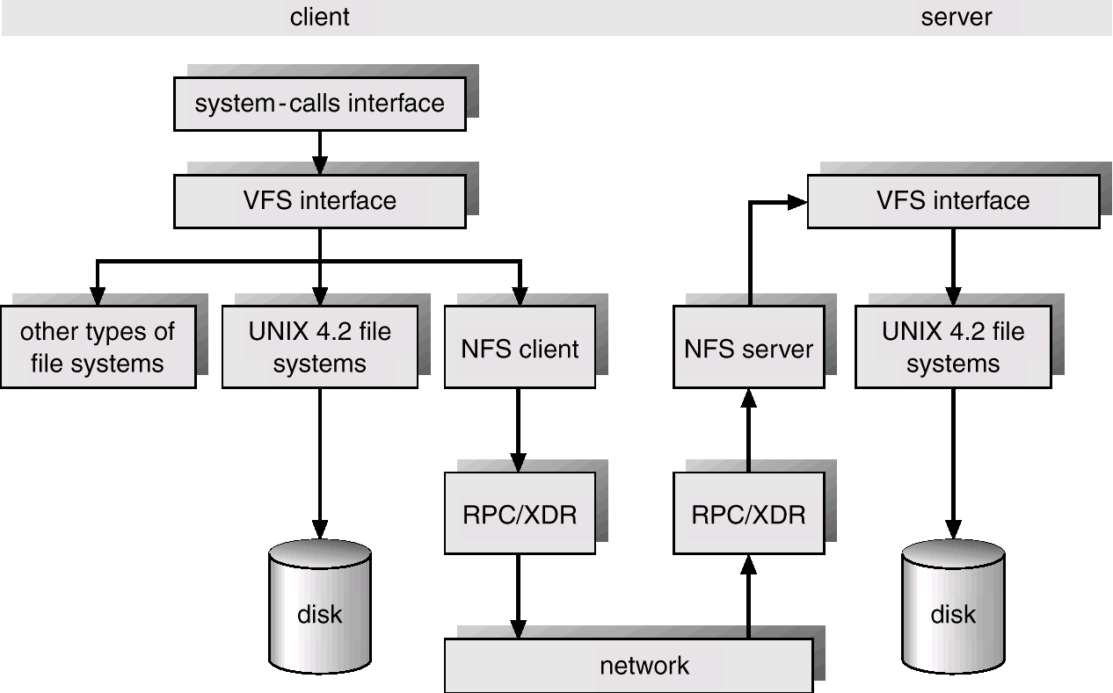
Schematic View of NFS Architecture

Slide 46
NFS Path-Name Translation
Performed by breaking the path into component names and performing a separate NFS lookup call for every pair of component name and directory vnode.
To make lookup faster, a directory name lookup cache on the client’s side holds the vnodes for remote directory names.

Slide 47
NFS Remote Operations
Nearly one-to-one correspondence between regular UNIX system calls and the NFS protocol RPCs (except opening and closing files).
NFS adheres to the remote-service paradigm, but employs buffering and caching techniques for the sake of performance.
File-blocks cache – when a file is opened, the kernel checks with the remote server whether to fetch or revalidate the cached attributes. Cached file blocks are used only if the corresponding cached attributes are up to date.
File-attribute cache – the attribute cache is updated whenever new attributes arrive from the server.
Clients do not free delayed-write blocks until the server confirms that the data have been written to disk.

